Slide 1
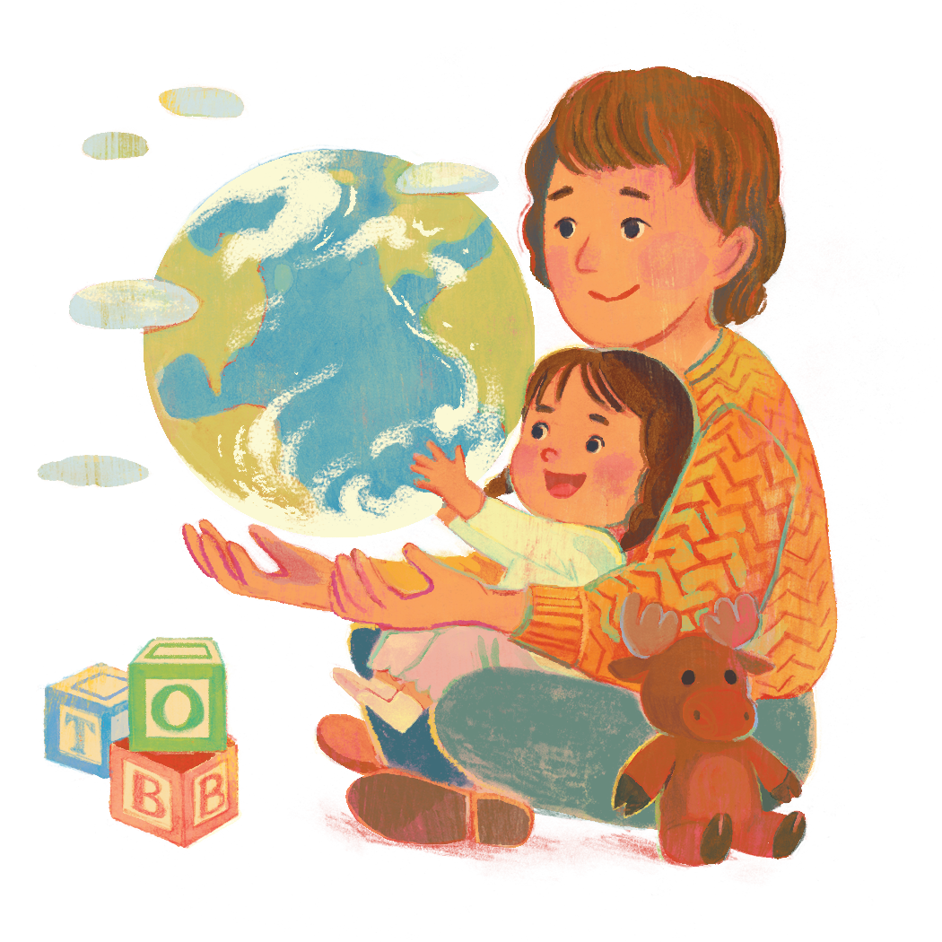
Let’s learn about
Sign Language
Around the World

Slide 2

What languages will we EXPLORE today?
American Sign Language (ASL)
Bangla Sign Language (BdSL)
Filipino Sign Language (FSL)
Ugandan Sign Language (USL)
Sign languages are unique and complete languages.
They are distinct from each other and their country’s spoken languages.

Slide 3
LET’S sign TOGETHER!

Slide 4
LET’S sign TOGETHER!
friend

Slide 5
LET’S sign TOGETHER!
friend
book

Slide 6
LET’S sign TOGETHER!
friend
book
water

Slide 7
LET’S sign TOGETHER!
friend
book
thank you
water

Slide 8
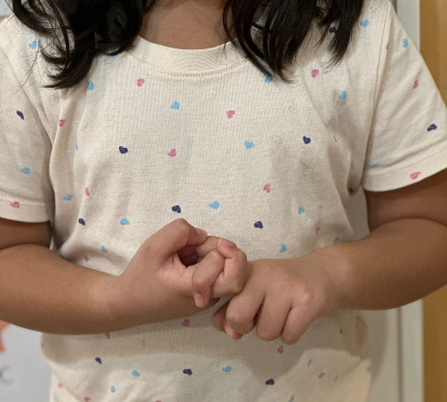
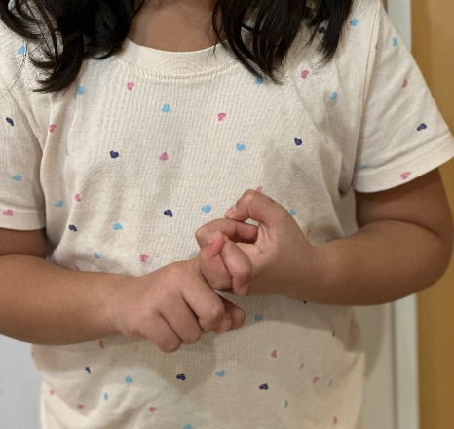
Let’s sign the word for FRIEND
ASL | BdSL | FSL | USL
friend | bondhu | kaibigan | mukwano
Hook your pointer fingers together, then switch them back and forth.
This is the same sign in ASL, FSL and USL.

Slide 9
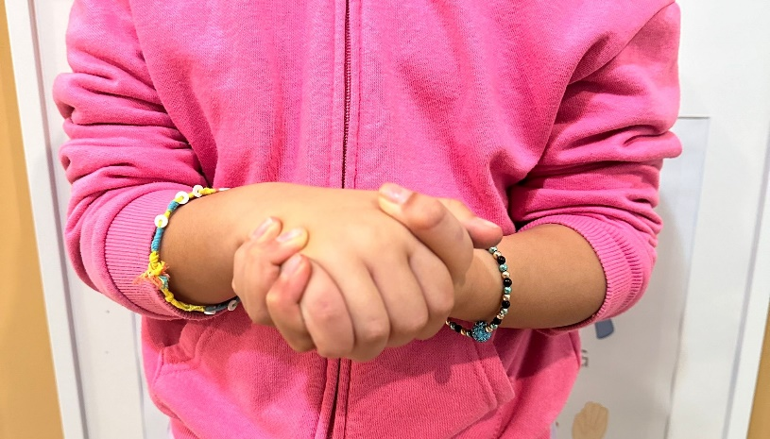
Let’s sign the word for FRIEND
ASL | BdSL | FSL | USL
friend | bondhu | kaibigan | mukwano
A similar way of signing “friend” can be seen in Bangla Sign Language:
clasp hands across each other and shake firmly.

Slide 10
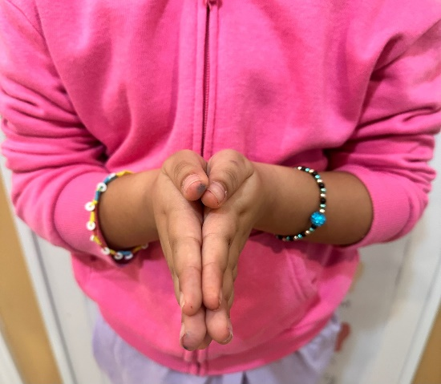
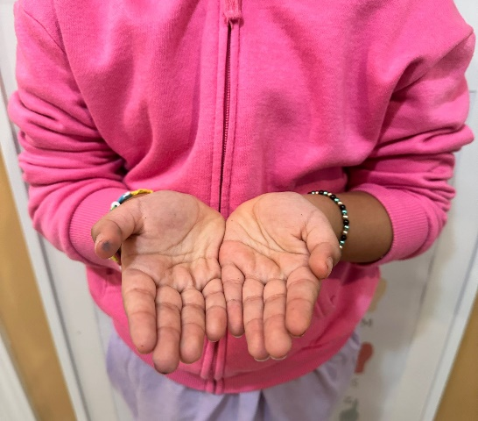
Let’s sign the word for BOOK
ASL | BdSL | FSL | USL
book | boi | libro | ekitabo
American Sign Language and Filipino Sign Language
Palms touching, fingers pointing away, then open up hands, pinky fingers still touching, as if opening pages of a book.

Slide 11
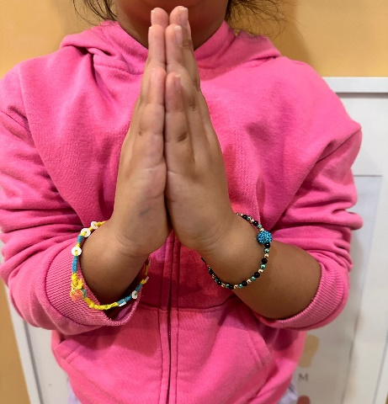
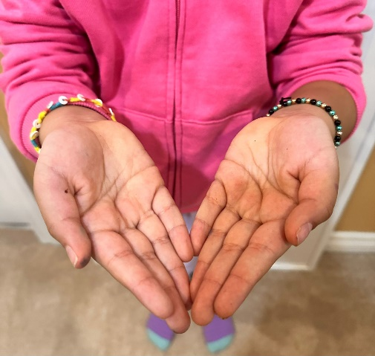
Let’s sign the word for BOOK
ASL | BdSL | FSL | USL
book | boi | libro | ekitabo
Bangla Sign Language
Palms touching, fingers pointing up, then open up hands and drop them down, with just fingertips still touching.

Slide 12
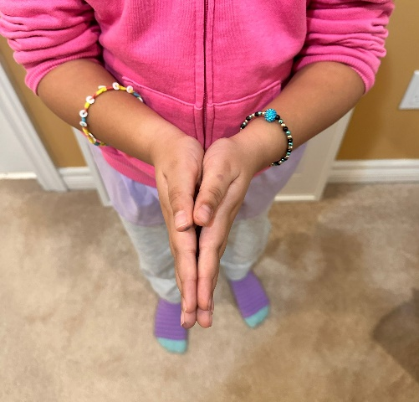
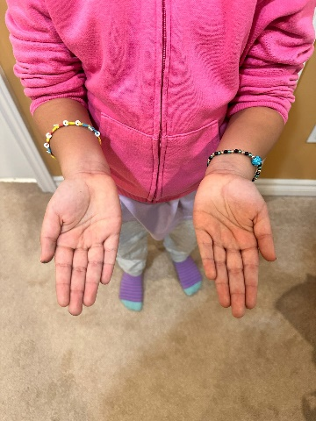
Let’s sign the word for BOOK
ASL | BdSL | FSL | USL
book | boi | libro | ekitabo
Ugandan Sign Language
Palms touching, fingers pointing away, then open hands out and slightly apart

Slide 13
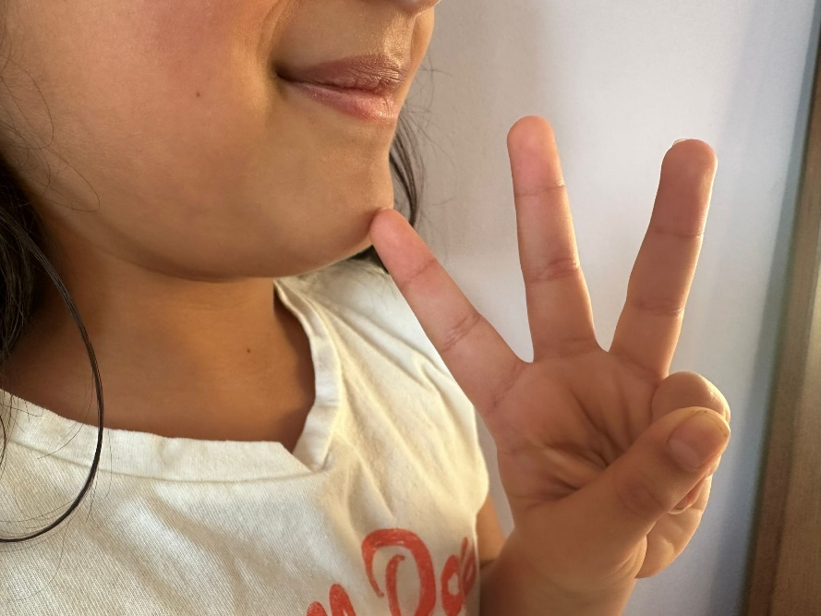
Let’s sign the word for WATER
ASL | BdSL | FSL | USL
water | paani | tubig | amazzi
American Sign Language, Filipino Sign Language and Ugandan Sign Language:
Make “w” shape with fingers and tap sideways against chin

Slide 14
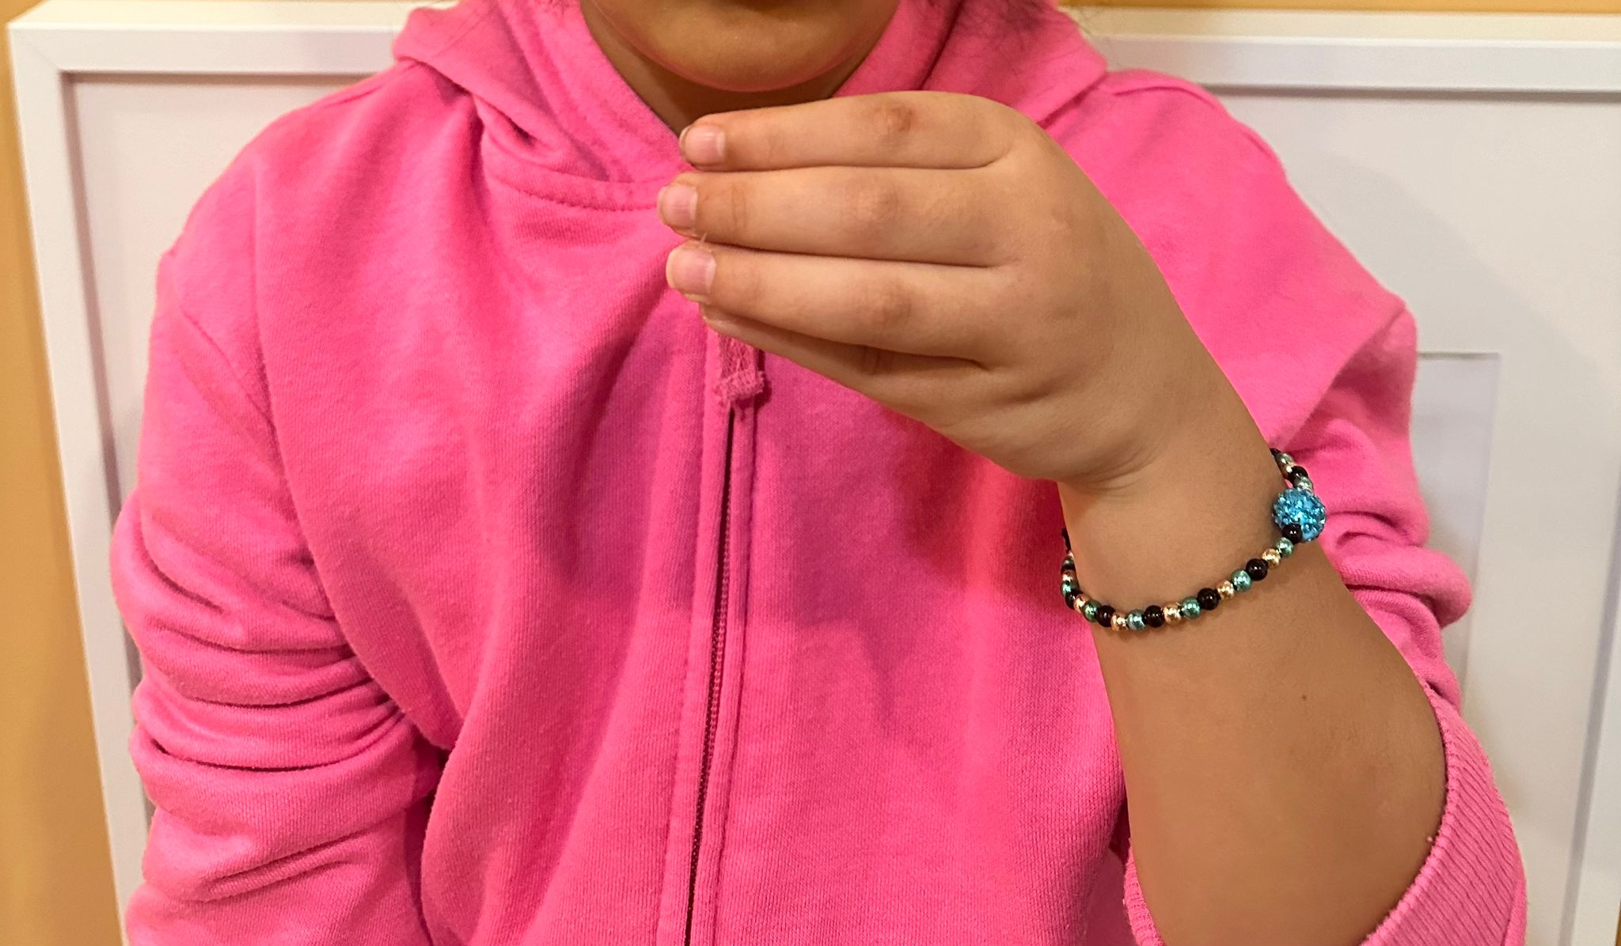
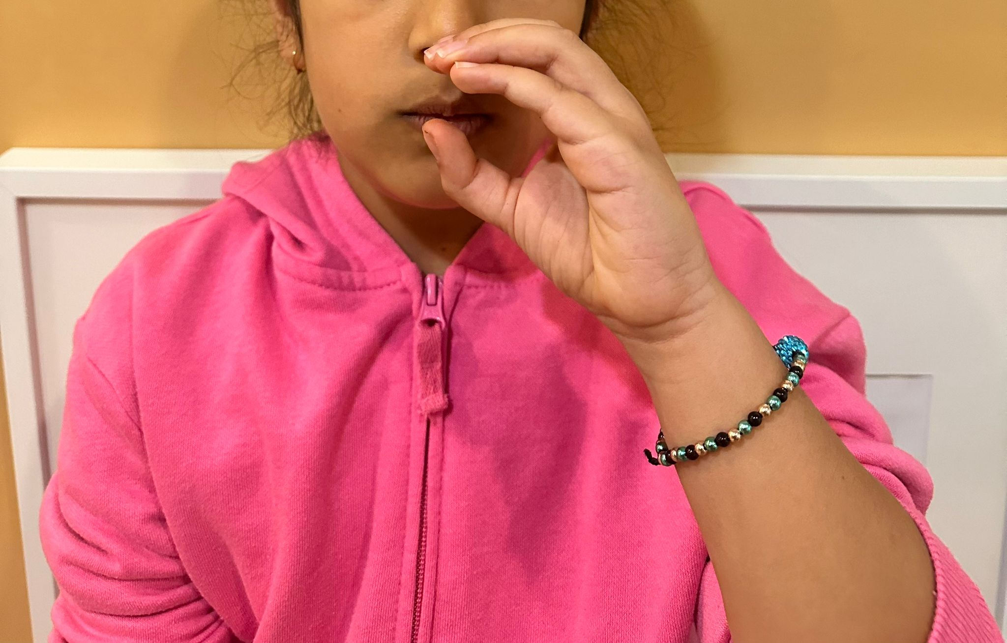
Let’s sign the word for WATER
ASL | BdSL | FSL | USL
water | paani | tubig | amazzi
Bangla Sign Language:
Make “c” cup shape and bring to lips

Slide 15
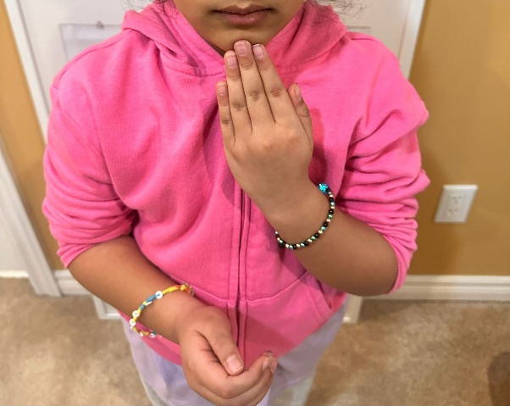
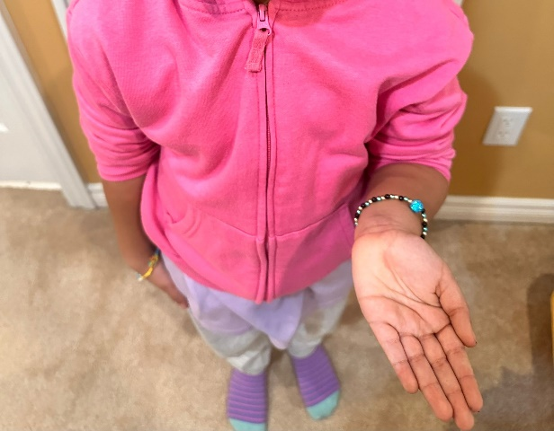
Let’s sign the phrase THANK YOU
ASL | BdSL | FSL | USL
thank you | dhonnobhad | salamat po | webale
American Sign Language and Bangla Sign Language:
Lift hand to chin, then down and out in one motion

Slide 16
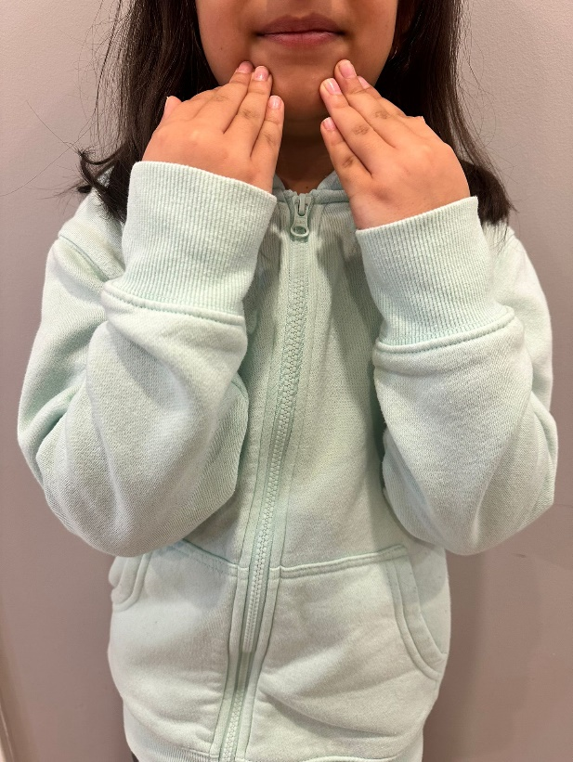
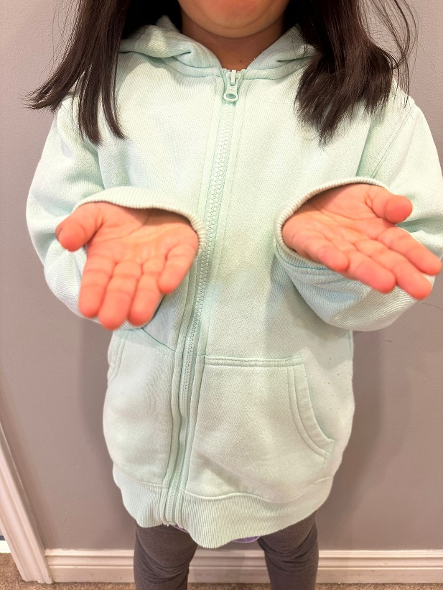
Let’s sign the phrase THANK YOU
ASL | BdSL | FSL | USL
thank you | dhonnobhad | salamat po | webale
Filipino Sign Language and Ugandan Sign Language:
The same as ASL, but with both hands.
Lift both hands to chin. Lower hands down and out.

Slide 17

There are so many ways to LEARN and SHARE
Thanks for participating!

